Slide 1
Creating storage account,Container and uploading a .txt file into it

Slide 2
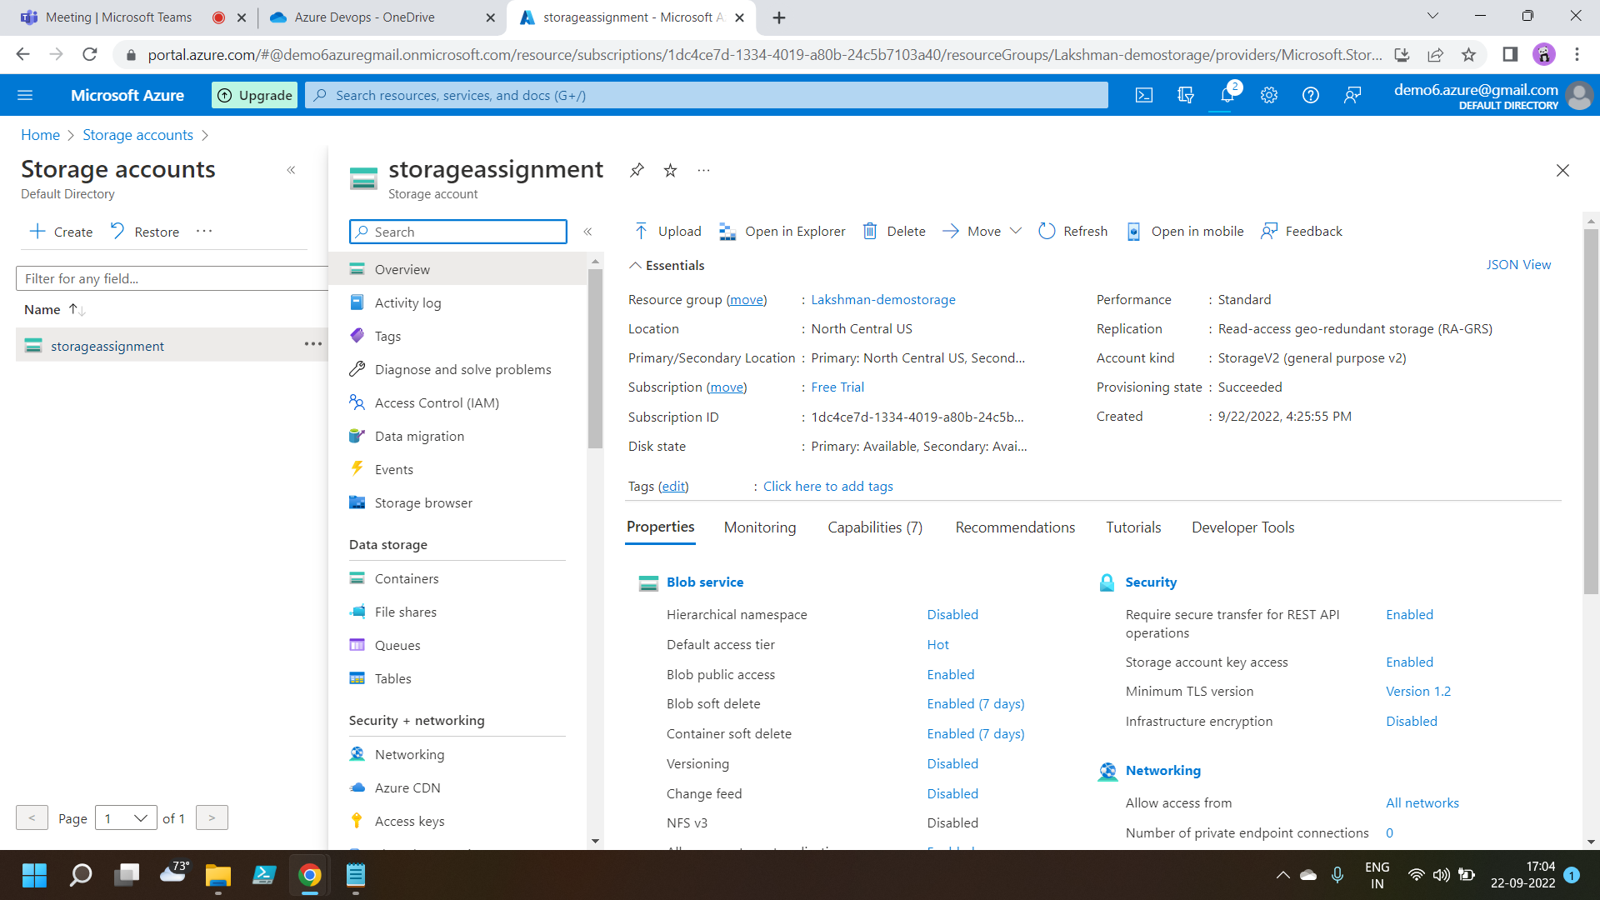
Creating a storage account

Slide 3
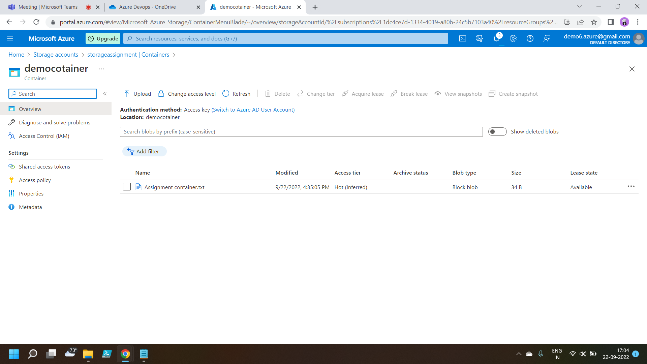
Creating a Container and inserting a .txt file into it

